Slide 1
Emotion Roulette

Slide 2


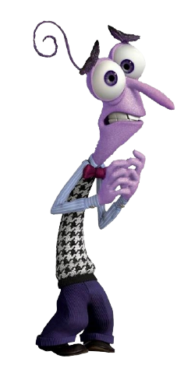


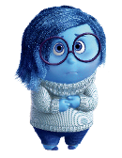


Happy/Joy
Star Jumps
Mad/Angry
Stomp
Sad/Upset
Tip Toe
Scared/Worried
Wiggle

Slide 3
GET READY!!!!!

